Slide 1
Events

Slide 2
What is event ???

Slide 3
Event
An event is a signal that something has happened. All DOM nodes generate such signals (but events are not limited to DOM).

Slide 4
Event
Mouse events:
click – when the mouse clicks on an element (touchscreen devices generate it on a tap).
contextmenu – when the mouse right-clicks on an element.
mouseover / mouseout – when the mouse cursor comes over / leaves an element.
mousedown / mouseup – when the mouse button is pressed / released over an element.
mousemove – when the mouse is moved.
Form element events:
submit – when the visitor submits a <form>.
focus – when the visitor focuses on an element, e.g. on an <input>
Keyboard events:
keydown and keyup – when the visitor presses and then releases the button.

Slide 5
Event Handler
To react on events we can assign a handler – a function that runs in case of an event.
Handlers is a way to run JavaScript code in case of user actions.

Slide 6
Event handler
HTML attribute
A handler can be set in HTML with an attribute named on<event>.
<input value="Click me" onclick="alert('Click!')" type="button">
---------------------------------------------------------------------------------------------------------------------------------------------
<script> function countRabbits() { for(let i=1; i<=3; i++) { alert("Rabbit number " + i); } } </script> <input type="button" onclick="countRabbits()" value="Count rabbits!">

Slide 7
Event handler
DOM property
We can assign a handler using a DOM property on<event>. For instance, elem.onclick
<input id="elem" type="button" value="Click me"> <script> elem.onclick = function() { alert('Thank you'); }; </script>

Slide 8
Event handler
HTML attribute vs DOM property
These two code pieces work the same:
<input type="button" onclick="alert('Click!')" value="Button">
----------------------------------------------------------------------------------------------------------------------
<input type="button" id="button" value="Button"> <script> button.onclick = function() { alert('Click!'); }; </script>

Slide 9
Event handler
As there’s only one onclick property, we can’t assign more than one event handler.

Slide 10
Event handler
Accessing the element: this
The value of this inside a handler is the element. The one which has the handler on it.
<button onclick="alert(this.innerHTML)">Click me</button>

Slide 11
addEventListener
The fundamental problem of the aforementioned ways to assign handlers – we can’t assign multiple handlers to one event.
Web-standard developers understood that long ago and suggested an alternative way of managing handlers using special methods addEventListener and removeEventListener. They are free of such a problem.

Slide 12
addEventListener syntax
element.addEventListener(event, handler[, phase]);
element.removeEventListener(event, handler[, phase]);
-----------------------------------------------------------------------------
function handler() { alert( 'Thanks!' ); } input.addEventListener("click", handler); // .... input.removeEventListener("click", handler);

Slide 13
Multiple event handlers
<input id="elem" type="button" value="Click me"/> <script> function handler1() { alert('Thanks!'); }; function handler2() { alert('Thanks again!'); } elem.onclick = () => alert("Hello"); elem.addEventListener("click", handler1); // Thanks! elem.addEventListener("click", handler2); // Thanks again! </script>

Slide 14
Event object
To properly handle an event we’d want to know more about what’s happened. Not just a “click” or a “keypress”, but what were the pointer coordinates? Which key was pressed? And so on.
When an event happens, the browser creates an event object, puts details into it and passes it as an argument to the handler.

Slide 15
Event object
<input type="button" value="Click me" id="elem"> <script> elem.onclick = function(event) { // show event type, element and coordinates of the click alert(event.type + " at " + event.currentTarget); alert("Coordinates: " + event.clientX + ":" + event.clientY); }; </script>

Slide 16
Event objects
Some properties of event object:
event.type
Event type, here it’s "click".
event.currentTarget
Element that handled the event. That’s exactly the same as this, unless you bind this to something else, and then event.currentTarget becomes useful.
event.clientX / event.clientY
Window-relative coordinates of the cursor, for mouse events.

Slide 17
Event objects
https://www.w3schools.com/jsref/obj_events.asp

Slide 18
Event bubbling and capturing

Slide 19
Event bubbling and capturing
Let’s start with an example.
This handler is assigned to <div>, but also runs if you click any nested tag like <em> or <code>:
<div onclick="alert('The handler!')"> <em>If you click on <code>EM</code>, the handler on <code>DIV</code> runs.</em> </div>

Slide 20
Bubbling
When an event happens on an element, it first runs the handlers on it, then on its parent, then all the way up on other ancestors.

Slide 21
Event bubbling
<style> body * { margin: 10px; border: 1px solid blue; } </style> <form onclick="alert('form')">FORM <div onclick="alert('div')">DIV <p onclick="alert('p')">P</p> </div> </form>

Slide 22
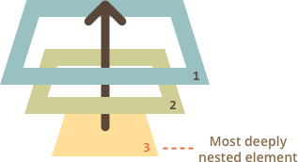
Event bubbling
So if we click on <p>, then we’ll see 3 alerts: p → div → form.

Slide 23
event.target
A handler on a parent element can always get the details about where it actually happened.
The most deeply nested element that caused the event is called a target element, accessible as event.target.
Note the differences from this (=event.currentTarget):
event.target – is the “target” element that initiated the event, it doesn’t change through the bubbling process.
this – is the “current” element, the one that has a currently running handler on it.

Slide 24
Capturing
The standard DOM Events describes 3 phases of event propagation:
Capturing phase – the event goes down to the element.
Target phase – the event reached the target element.
Bubbling phase – the event bubbles up from the element.

Slide 25
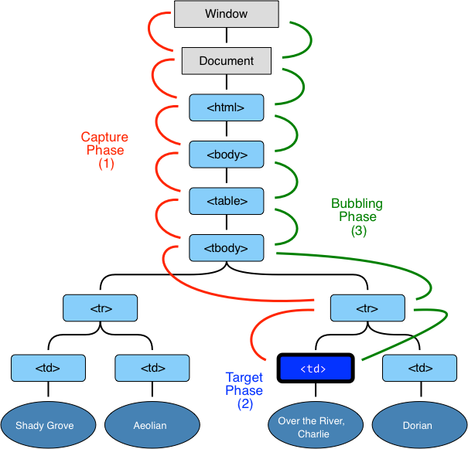
Capturing

Slide 26
Capturing
Before we only talked about bubbling, because the capturing phase is rarely used. Normally it is invisible to us.
Handlers added using on<event>-property or using HTML attributes or using addEventListener(event, handler) don’t know anything about capturing, they only run on the 2nd and 3rd phases. To catch an event on the capturing phase, we need to set the 3rd argument of addEventListener to true.
There are two possible values for that optional last argument:
If it’s false (default), then the handler is set on the bubbling phase.
If it’s true, then the handler is set on the capturing phase.

Slide 27
Capturing
<style> body * { margin: 10px; border: 1px solid blue; } </style> <form>FORM <div>DIV <p>P</p> </div> </form> <script> for(let elem of document.querySelectorAll('*')) { elem.addEventListener("click", e => alert(`Capturing: ${elem.tagName}`), true); elem.addEventListener("click", e => alert(`Bubbling: ${elem.tagName}`)); } </script>

Slide 28
Capturing
If you click on <p>, then the sequence is:
HTML → BODY → FORM → DIV → P (capturing phase, the first listener), and then:
P → DIV → FORM → BODY → HTML (bubbling phase, the second listener).

Slide 29
?

